Slide 1


Banking/Lending
DSC 680
Adrian Rybinski
Monitoring for Bias in Loan Decisions

Slide 2

Table of Contents
Introduction/Problem Statement 3
Business Objective and Opportunity 4
Market Analysis and Regulatory Scrutiny 5
Data Analysis 6-8
Initial Observations and Results 9-10
Project Risks and Opportunities 11
Questions and Answers 12
References 13

Slide 3


Introduction/Problem Statement
WHY ARE WE INVESTING IN THE PROJECT
Banking has been under the constant watch of federal regulators for any violation of lending rules.
The main business problem we want to solve is how to detect if there was bias in a decision based on a protected class.
Secondary problem statement is the avoidance of government penalties and reputational degradation

Slide 4



Business Objective and Opportunity
WHAT ARE WE PLANNING TO ACCOMPLISH
With this project undertaking we plan to:
Address public perception of bias and discrimination in the financial industry lending operations
Detect unconscious bias in lending decisions
Enhance the risk management framework
Ensure regulatory requirement are adhered

Slide 5
Market Analysis and Regulatory Scrutiny
WHERE ARE WE NOW AND WHAT IS CONCERNING
According to market research and results¹:
Mortgage market debt valued at 16.96 trillion dollars (USD)
In 2021, average interest rate = 2.9% (30 years) and 2.28% (15 years)
Rates have since significantly increased putting additional pressure on the minorities
African Americans are twice as likely to be denied
87% of mortgage applicants are white
African-American and Hispanic use high-cost mortgages
¹ See reference tab for source of data

Slide 6
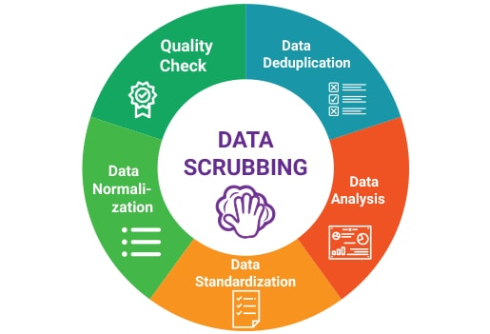
Data Analysis
WHAT HAVE WE DONE SO FAR
For the purposes of the model development, we have completed the following:
Obtained over 600K records from the FFIEC data base
Selected race, income, and gender/sex, and property value as the main features
Cleaned/removed unused data
Developed categories for visualizations
Prepared data to be binary values for model fitting

Slide 7
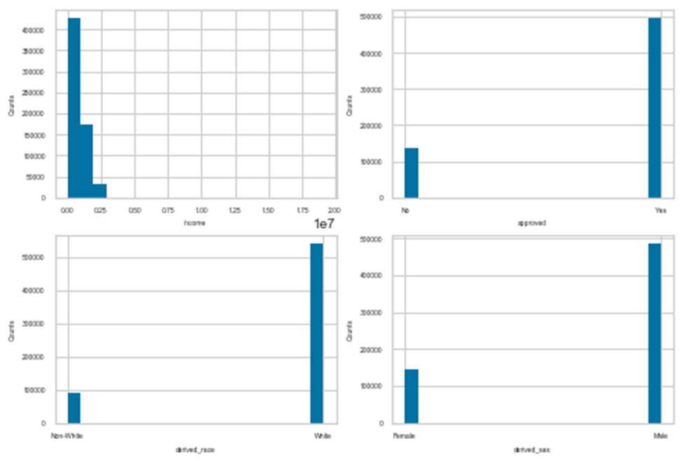
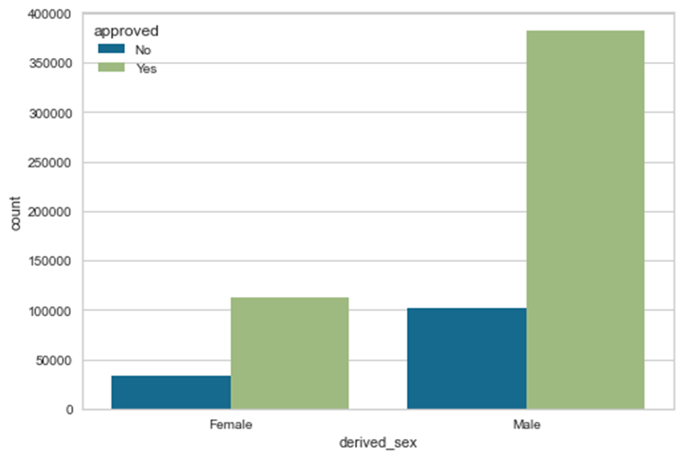
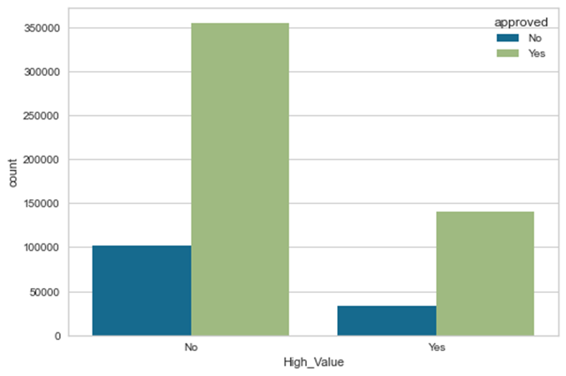
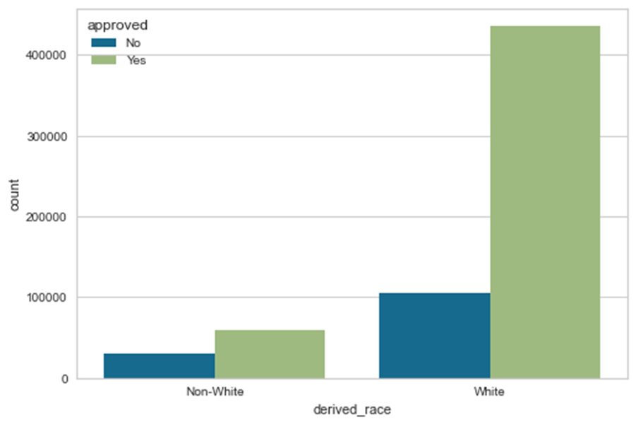
Data Analysis (continued)
WHAT HAVE WE SEEN SO FAR
For the purposes of the model development, we have uncovered the following patterns and insights:
There is a bias in the data where males and/or white applicants are approved more often than non-white applicants or females.
Property Value has been determined to be an inverse of the assumption that a higher value guarantees approval

Slide 8
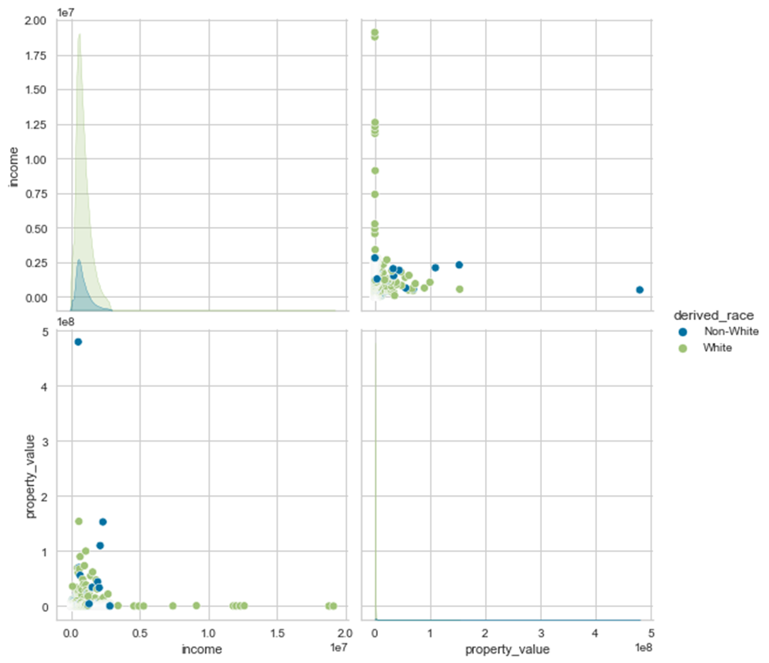
Data Analysis (continued)
WHAT HAVE WE SEEN SO FAR
The data is skewed with a few outliers
Income and Property Value seem to be correlated as expected
There is a higher number of white applications as compared to non-white applicants

Slide 9
Initial Observations and Results
HOW IS THE MODEL PERFORMING
Model/Algorithm | Score | Standard Deviation
Logistic Regression | 0.785948 | 0.000002
Linear Discriminant Analysis | 0.785948 | 0.000002
K Neighbors Classifier | 0.762140 | 0.032113
Decision Tree Classifier | 0.785948 | 0.000002
Gaussian Naïve Bayes | 0.755361 | 0.001234
Linear Support Vector Classifier | 0.785948 | 0.000002
Results are meeting expectations
The accuracy of the model has improved (63% vs 76%)
Resource allocation is preventing higher accuracy as expected
Additional computing resource needed

Slide 10
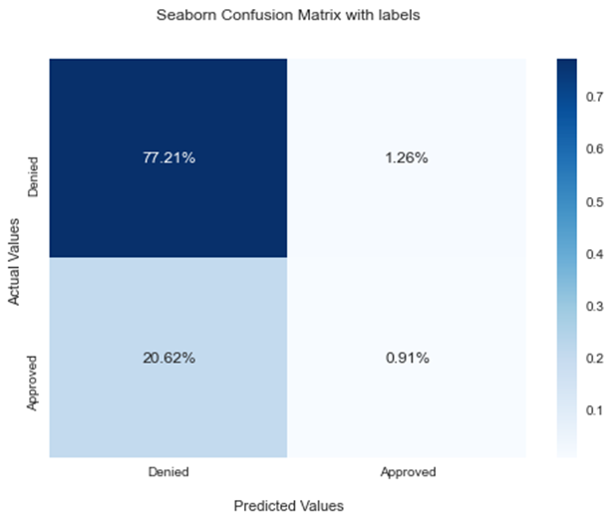
Initial Observations and Results (cont.)
HOW IS THE MODEL PERFORMING
All models have a high accuracy score over 75%
Some models do not have a high precision or recall as seen in the confusion matrices.
K Neighbor Classifier has shown the most promise
 | Precision | Recall | F1-Score | Support
No | 0.79 | 0.98 | 0.88 | 98920
Yes | 0.42 | 0.04 | 0.08 | 27137
Accuracy |  |  | 0.78 | 126057
Macro Avg | 0.60 | 0.51 | 0.48 | 126057
Weighted Avg | 0.71 | 0.78 | 0.70 | 126057

Slide 11
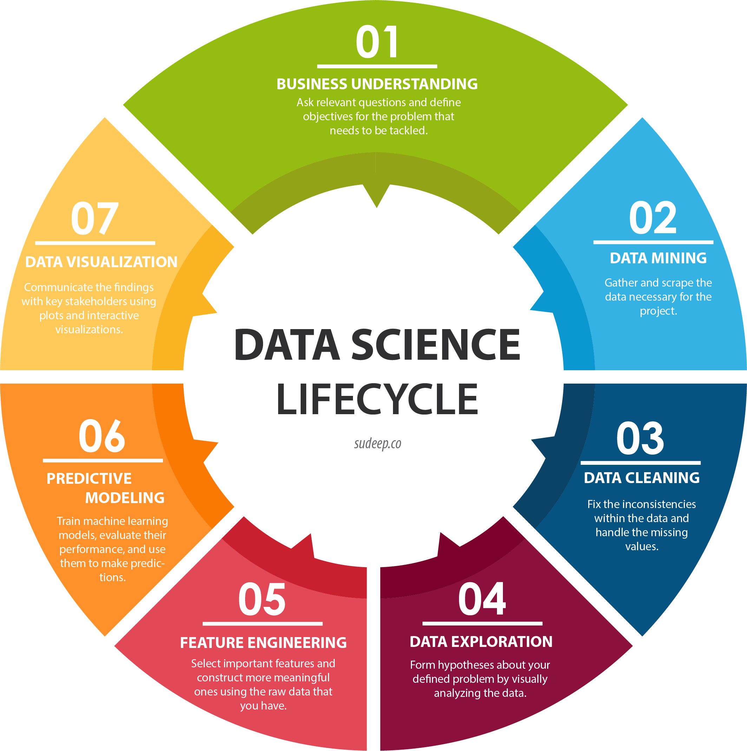

Project Risks and Opportunities
HOW ARE WE GOING TO IMPROVE
Increase the model accuracy, recall, and precision (Model Tuning)
Address additional data for training (Resource Constraints)
Low Precision = BAD DECISONS

Slide 12

Questions and Answers

Slide 13
References
WHERE IS THE DATA COMING FROM
FFIEC/CFPB. HMDA Datasets. Retrieved from https://ffiec.cfpb.gov/data-browser/data/2018?category=states on September 30, 2021
Tekin, E. (August 3, 2021). Clever. Exploring Racial Discrimination in Mortgage Lending: A Call for Greater Transparency. Retrieved from https://listwithclever.com/research/racial-discrimination-in-mortgage-lending/ on October 29, 2021
Statista Research Department (October 29, 2021). U.S. mortgage industry - statistics & facts. Retrieved from https://www.statista.com/topics/1685/mortgage-industry-of-the-united-states/#dossierKeyfigures on October 30, 2021

